Slide 1
Rock Star Meetings!
AADE Leadership Series

Slide 2
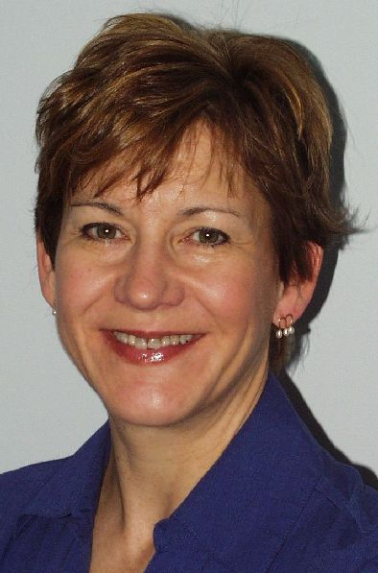
The Next 60 minutes …
Talk about what makes an event rock
Few basic tenets of event planning
Couple of ideas on choosing content
10 examples of events that ROCKED
Leading the conversation …
Peggy Hoffman, CAE
Association manager
Event planner
Social media fan

Slide 3
What makes an event rock?
No. of people
No. of CEs
Level of applause
Profit
Level of ENERGY in the room
✗
✗
✗
✗

Slide 4
How do you create high energy?
Mix:
2 parts CONTENT
3 parts Ambiance
5 parts FUN

Slide 5
Basic tenets are:
Topic of interest … in a different fashion
Networking galore!
Keep the event alive
It’s a team effort
Registration cost competitive
Begin with fun marketing
Don’t forget to evaluate!
Make events simple to put on

Slide 6
So how do you pick the topic?
“Throw it out there and see if it sticks”
Track past events
Steal ideas
1 question polls

Slide 7
Speed Series
Speed Networking
Speed Mentoring
Speed Pitching
Speed Recaps

Slide 8
Hands-on Series
Social media series
Writing workshop
Baltimore Clayworks
Zumba Class

Slide 9
Roundtable Series
Today’s Hot Topics
Morning Topics Revisited

Slide 10
Virtual Options
Virtual Lunch Dates
Teleseminars / Webinar Tie-in

Slide 11
Meet-ups
Café Conversations
Tuesday morning series

Slide 12
Arts & Edu-tainment
Embassy Series
Social/Learning Events

Slide 13
Guided conference
Facilitator
Pre-event assignment helped attendees prepare for event

Slide 14
Ways to add a dash of different:
Closing Session - Opened “the wall”
Morning Topics Revisited
Idea Tree – growing ideas
Capturing the fun of a multi-day event with Flickr

Slide 15
May your events rock!
Created by Peggy Hoffman, CAE
Mariner Management & Marketing
www.marinermanagement.com
@peggyhoffman

